Slide 1
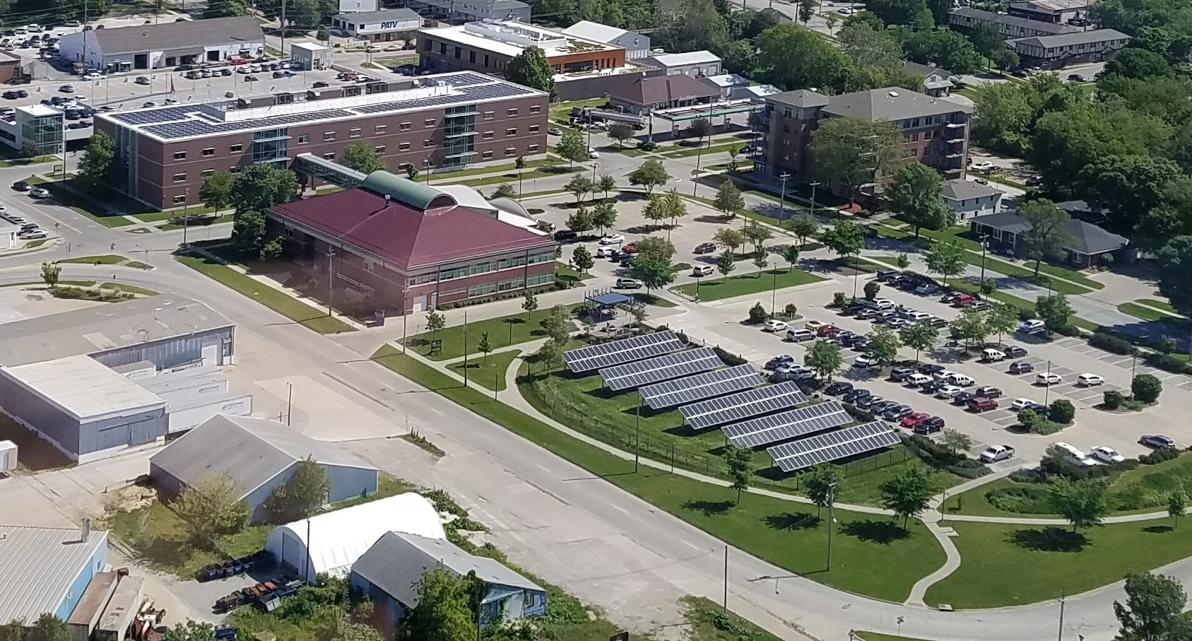
ADVANCING SOLAR IN JOHNSON COUNTY
Mike Carberry, Board of Supervisors
November 2018

Slide 2
Three Programs to Highlight
– 2017
– 2018
Solar added to County facilities – efforts since 2014

Slide 3
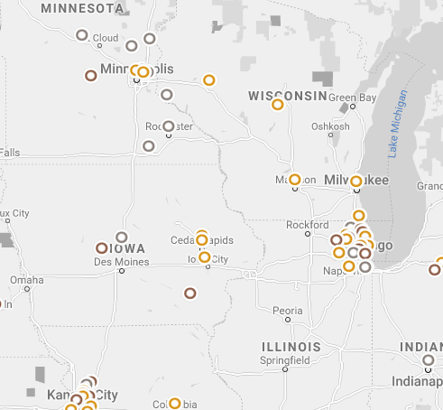
National program to improve solar use in cities, counties and towns.
Cities/counties get assistance to improve and apply for recognition.

Slide 4
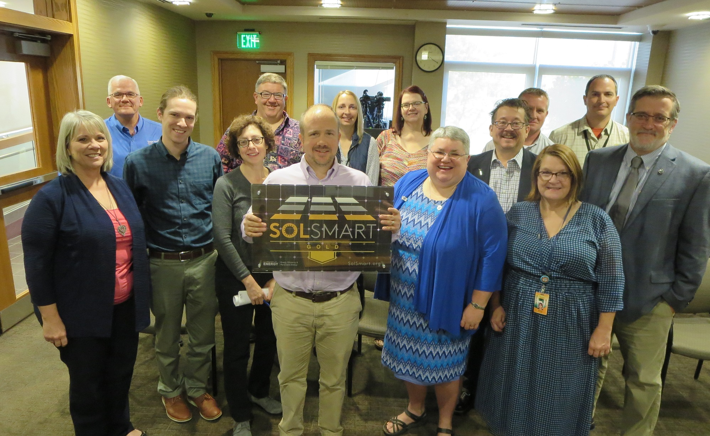
Johnson County was the first entity in Iowa to receive the Gold-level recognition.
Pretty picture

Slide 5
Planning, Development and Sustainability Department handled the application and efforts.
Improvements for our jurisdiction (unincorporated areas):
Codified Solar as an accessory use.
Created a Solar PV System checklist; posted online.
Ensured use of a flat $100 fee for residential solar.
More on next slide!

Slide 6
Other Highlights of the Gold Award from SolSmart
Ensured permit applications are reviewed within three business days and created a statement about this.
Earned points because we offer specific appointment times for inspections.
Showed our inspectors complete solar training.
Demonstrated action in state-level conversations on solar.
Notes:
Regarding being active in state-level conservations: The Johnson County Board of Supervisors sent a letter (6/12/2015) regarding distributed generation and net-metering to the Iowa Utilities Board and coordinated with the Winnishiek Energy District

Slide 7
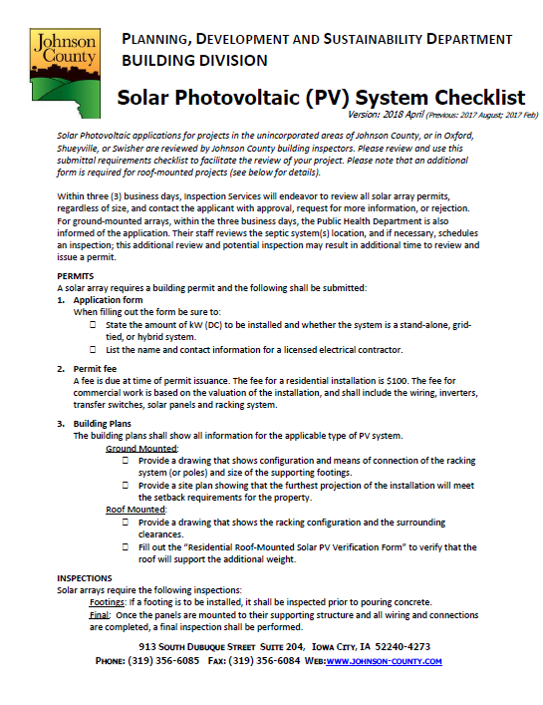
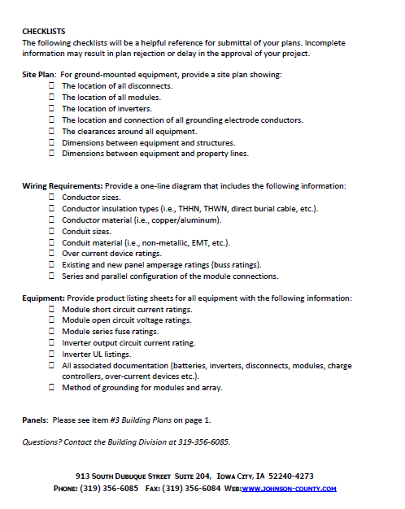
You can find our solar PV checklist online at www.Johnson-county.com/planning.
Click on “Development and
Building Services” then
“Building Services” to find it.

Slide 8
Helping residents in the incorporated and unincorporated areas get solar for their homes through a group buy

Slide 9
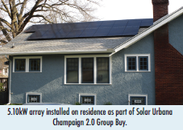
“Solarize” Program Main Goal
Make communities more sustainable by making solar faster, easier, and more affordable.
Bring smaller solar projects together so…
Everyone participating gets a more affordable price for an actual array attached to their own home
Educate people, so even if they don’t get solar, they know more about it.
Solarize group buy uses
“economies of scale”
It’s NOT one big community solar garden.
Notes:
A business owner could participate
but some entities may be able to get as good or better pricing
by going directly to any installer because their project will be so large on its own.

Slide 10
Inspiration: Solarize Cedar Rapids and Linn County (2017)
607.22 kW on 104 homes/businesses (goal: 350 kW)
More than 1 in 5 of meeting attendees got solar
Estimated Year 1 total utility savings: $105,571.08
CO₂ Offset Year 1: 947,267 pounds (v. fossil fuel)
Partners: Midwest Renewable Energy Association with Cedar Rapids as lead, Linn County Public Health, Linn County Government, Indian Creek Nature Center, Iowa350, The Nature Conservancy Iowa. The installer was Moxie Soarl.
Notes:
5.84 kW average size
(Large installations will likely get best pricing by working directly with any installer of their choice. This program is not for all entities; typical Solarize size is 6kW.)
Eric Holthaus Sustainability Coordinator for CR
was primary contact with MREA

Slide 11
Johnson County was the lead partner with the Midwest Renewable Energy Association
In Iowa, in addition to available tax credits, Solarize participants get a discount upfront from installer and additional discount as more households participate.
Interested cities were asked to commit by Jan. 5, 2018. No costs; only staff time to help host educational events.
www.SolarizeJohnsonCounty.com

Slide 12
Midwest Renewable Energy Association
Independent, non-profit organization
Experienced working with communities in four different Midwest states
Has led more than 20 Solarize programs
Administers program at no cost to counties/cities
Issues RFP; hosts Advisory Committee to select installer
Helps run the Program Group that publicizes the program and puts on educational events called Solar Power Hours
Notes:
Peter Murphy, based in Milwaukee, WI,
is the main contact with MREA.
Admin cost: Includes ten cent per watt fee to MREA after exceeds 50kW

Slide 13
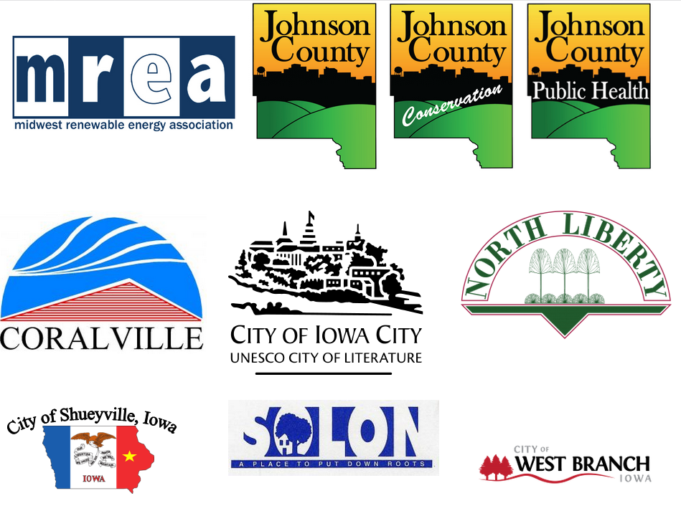
Partners: Cities and Departments Engaged
Sustainability Coordinator reached out to cities over several months to get engagement.
Cities helped host Solar Power Hours through early August: 22 events total

Slide 14
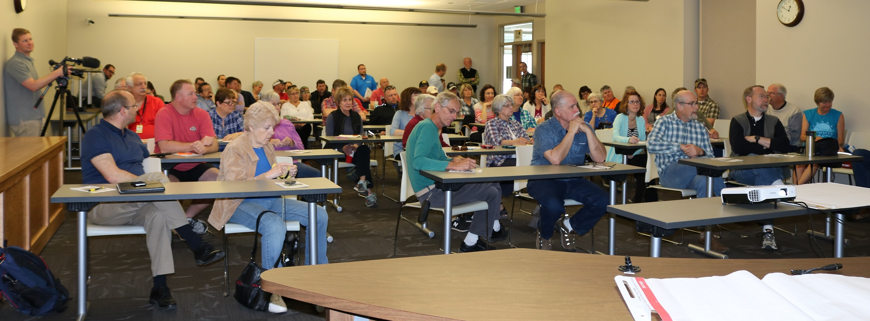
800 Residents Engaged
671 attended a Solar Power Hour
Others signed up at website
Got an estimate from installer (Moxie Solar)
Decided by end of August 2018 whether to go solar
If yes, signed up, and solar installed by the end of 2018
Already have about 60 estimates
Scheduled and four homes committed
Notes:
60+ homes already scheduled to get estimates

Slide 15
Results
181 Households
1.16 MW
$2.25 per watt for most
 | Annual kWh Estimate (Year 1) | Expected Year 1 Utility Savings | Expected Year 1 LB CO2 Offset | Expected Year 1 Gal H20 Offset
AVERAGE ARRAY: | 8,738 | $1,149 | 14,331 | 131,072
PROGRAM TOTALS: | 1,599,079 | $210,775 | 2,622,490 | 23,986,185
Notes:
Solarize Johnson County had 181 participating households
.
In table of figures I’ll highlight two...
First, in green, for the average household array, you see estimated Year 1 utility savings of nearly $1,150.
Second, regarding program totals, is the underlined GHG offset amount in pounds – more than 2.6 million
(CO2 equivalent) for the entire program.

Slide 16
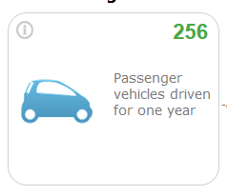
Equivalent to avoiding GHG emissions of..
First-year Expected Results
Source: EPA Equivalencies Calculator:
https://www.epa.gov/energy/greenhouse-gas-equivalencies-calculator
Notes:
This nearly 2.6 million lbs of CO2 avoided is
Like avoiding the emissions of 256 passenger vehicles driven for 1 yr
You can get examples like this from an EPA equivalencies calculator
that is really helpful for showing program success.

Slide 17
Glad We Did It! Results…
Add and promote energy efficiency and renewables
Engage the public
Collaborate with other governments
Collaborate with other departments within organization
Support local/regional economy
MREA provides a great framework and support.
Notes:
First of all, we’re glad we participated in this program with MREA.
In add’n to the practical goal of adding solar arrays to our community
We were able to engage our residents in sustainability efforts.
In fact, this was the first county-wide external sustainability project we as a County hosted.
Solarize also helped us leverage and strengthen relationships within our own org.
And the end result supports an important industry and our local economy.
MREA…Peter Murphy!

Slide 18
SOLAR POWER FOR COUNTY FACILITIES

Slide 19
Nearly 400 kW installed since 2014
As if this all of this building’s electricity (plus a little extra!) were all solar-generated
Notes:
We’ve installed four arrays so far
Enough that it’s like our 31-thousand square foot admin building’s electricity runs entirely on solar

Slide 20
Board of Supervisors’ Commitment: 2014
Clean Energy
Local/State Impact
Potential Savings
Eagle Point array HHS roof
Notes:
The Johnson County Board of Supervisors recognized the importance of sustainability to county residents.
The Johnson County Supervisors adopted a strategic plan in 2014 that included five energy goals.
One goal focused on adding renewables.
In 2015 they even renamed the Planning and Zoning Department to Planning, Development and Sustainability to better reflect the department’s mission and tasks.

Slide 21
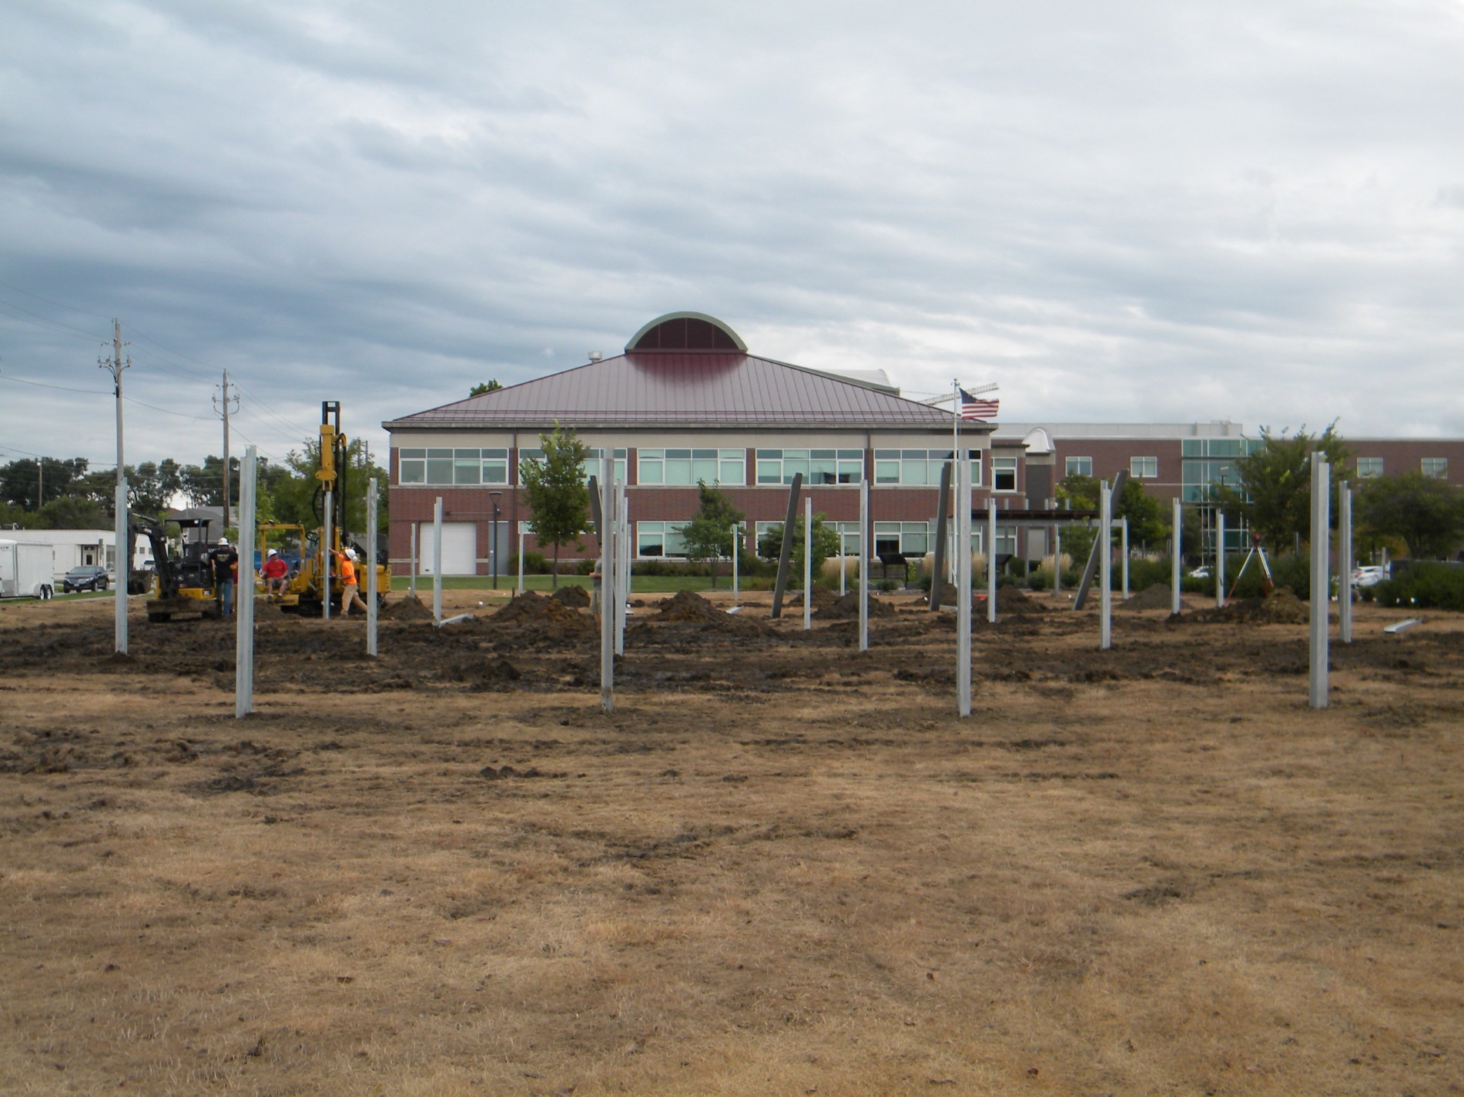
Typical Team for Our Array Projects
Planning, Development and Sustainability
Physical Plant (Facilities)
County Attorney Office
IT and Finance
Eagle Point array in progress, fall 2016
Notes:
We’ve helped other municipalities and entities from cities to the state courts to a nonprofit organization called Camp Courageous.

Slide 22
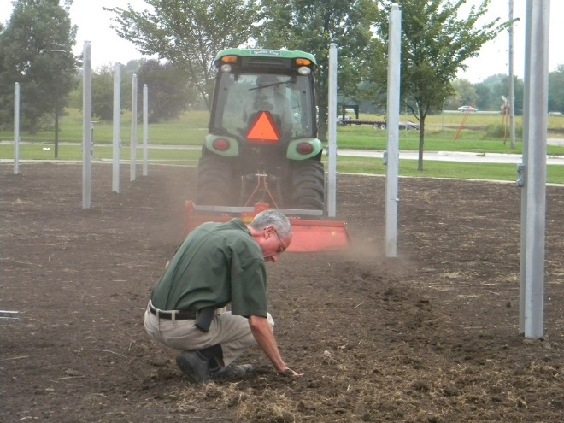
Notes:
We got this 1000 Friends of Iowa Innovative Leadership award in 2016for the Administration Building ground-mount solar project.
The project included soil quality improvement and stormwater features.
The efforts also helped us earn the SolSmart Gold award.

Slide 23
Power Purchase Agreement
Renewables Tax Credits
State: 18% of cost when we first started doing projects; now 15% (up to $20,000 commercial)
But governments cannot receive tax credits so…
Federal: 30% of cost (through 2019)
Notes:
Most of the County’s arrays use a Power Purchase Agreement to help leverage tax credits.
Currently, the federal rebate is 30% and that will continue through 2019.
The Iowa rate was 18% when we were signing our PPAs and now it is 15%.
In the future the federal rate will decrease, and so will Iowa’s since it’s based on the federal rate

Slide 24
What is A Power Purchase Agreement (PPA)
Contract between a taxable company that installs and operates a solar PV (or other energy) system on a purchaser’s premises, and that purchaser buys the power.
NREL PPA Checklist
Notes:
A Power Purchase
What is it? [Read definition]
Solar company installed, maintains and owns the array at Johnson County for the designated period
We buy the energy during that time
After the PPA ends, the arrays are ours for a termination fee.
Keep this link here just for ref.
http://www.nrel.gov/docs/fy10osti/46668.pdf

Slide 25
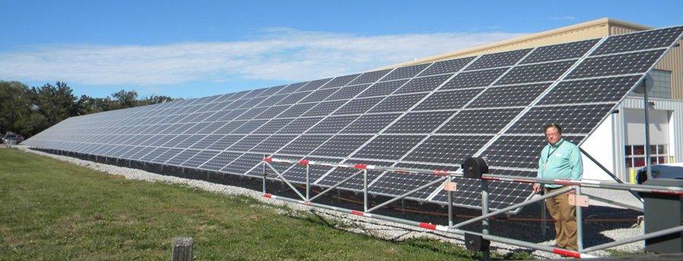
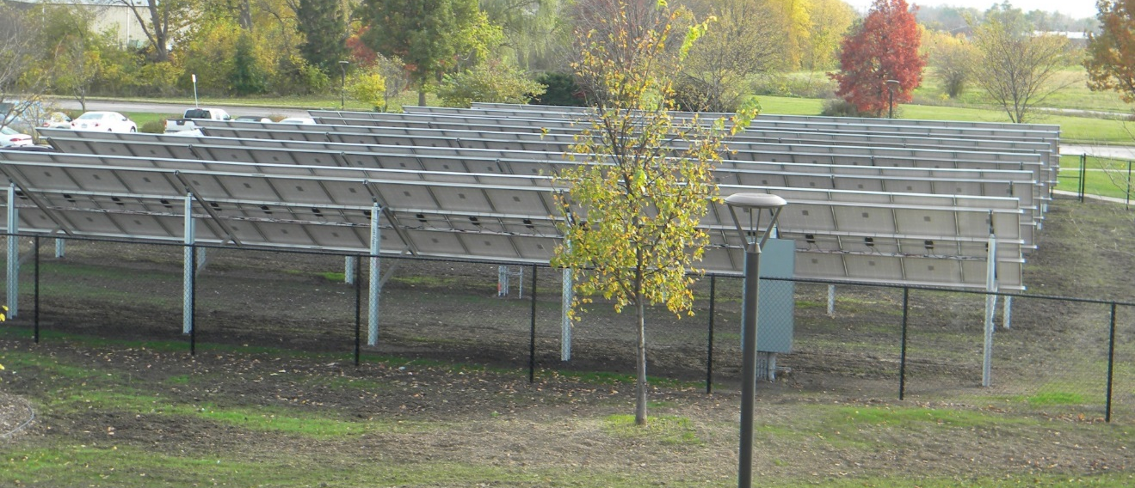
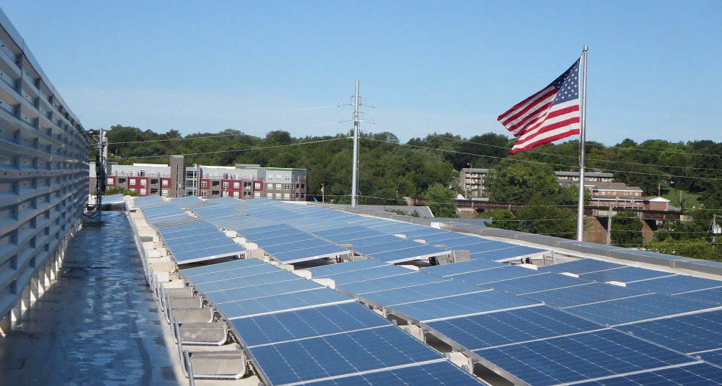
POWER PURCHASE AGREEMENTS (PPA)
Ground-mount
Secondary Roads
Micro-inverters; 15.16 kW + 70.56 kW, 10-year PPA (Moxie Solar)
Ground-mount
Admin Bldg
String inverters
85.8 kW
20-year PPA (Eagle Point)
Roof-top HHS
Central inverter
159.6 kW
20-year PPA (Eagle Point)
Notes:
Here’s an overview of our solar renewables that are Power Purchase Agreements
There are two ground-mount arrays at the Secondary Roads Campus, a15 kW system and a 71 kW System.
Both of those are on 10-year Power Purchase Agreements with Moxie Solar.
There are two more recent arrays built and owned by Eagle Point
86 kW system outside the Admin Building and a nearly 160 kW array on the roof of the Health and Human Services Building
These are longer PPAs at 20 years.

Slide 26
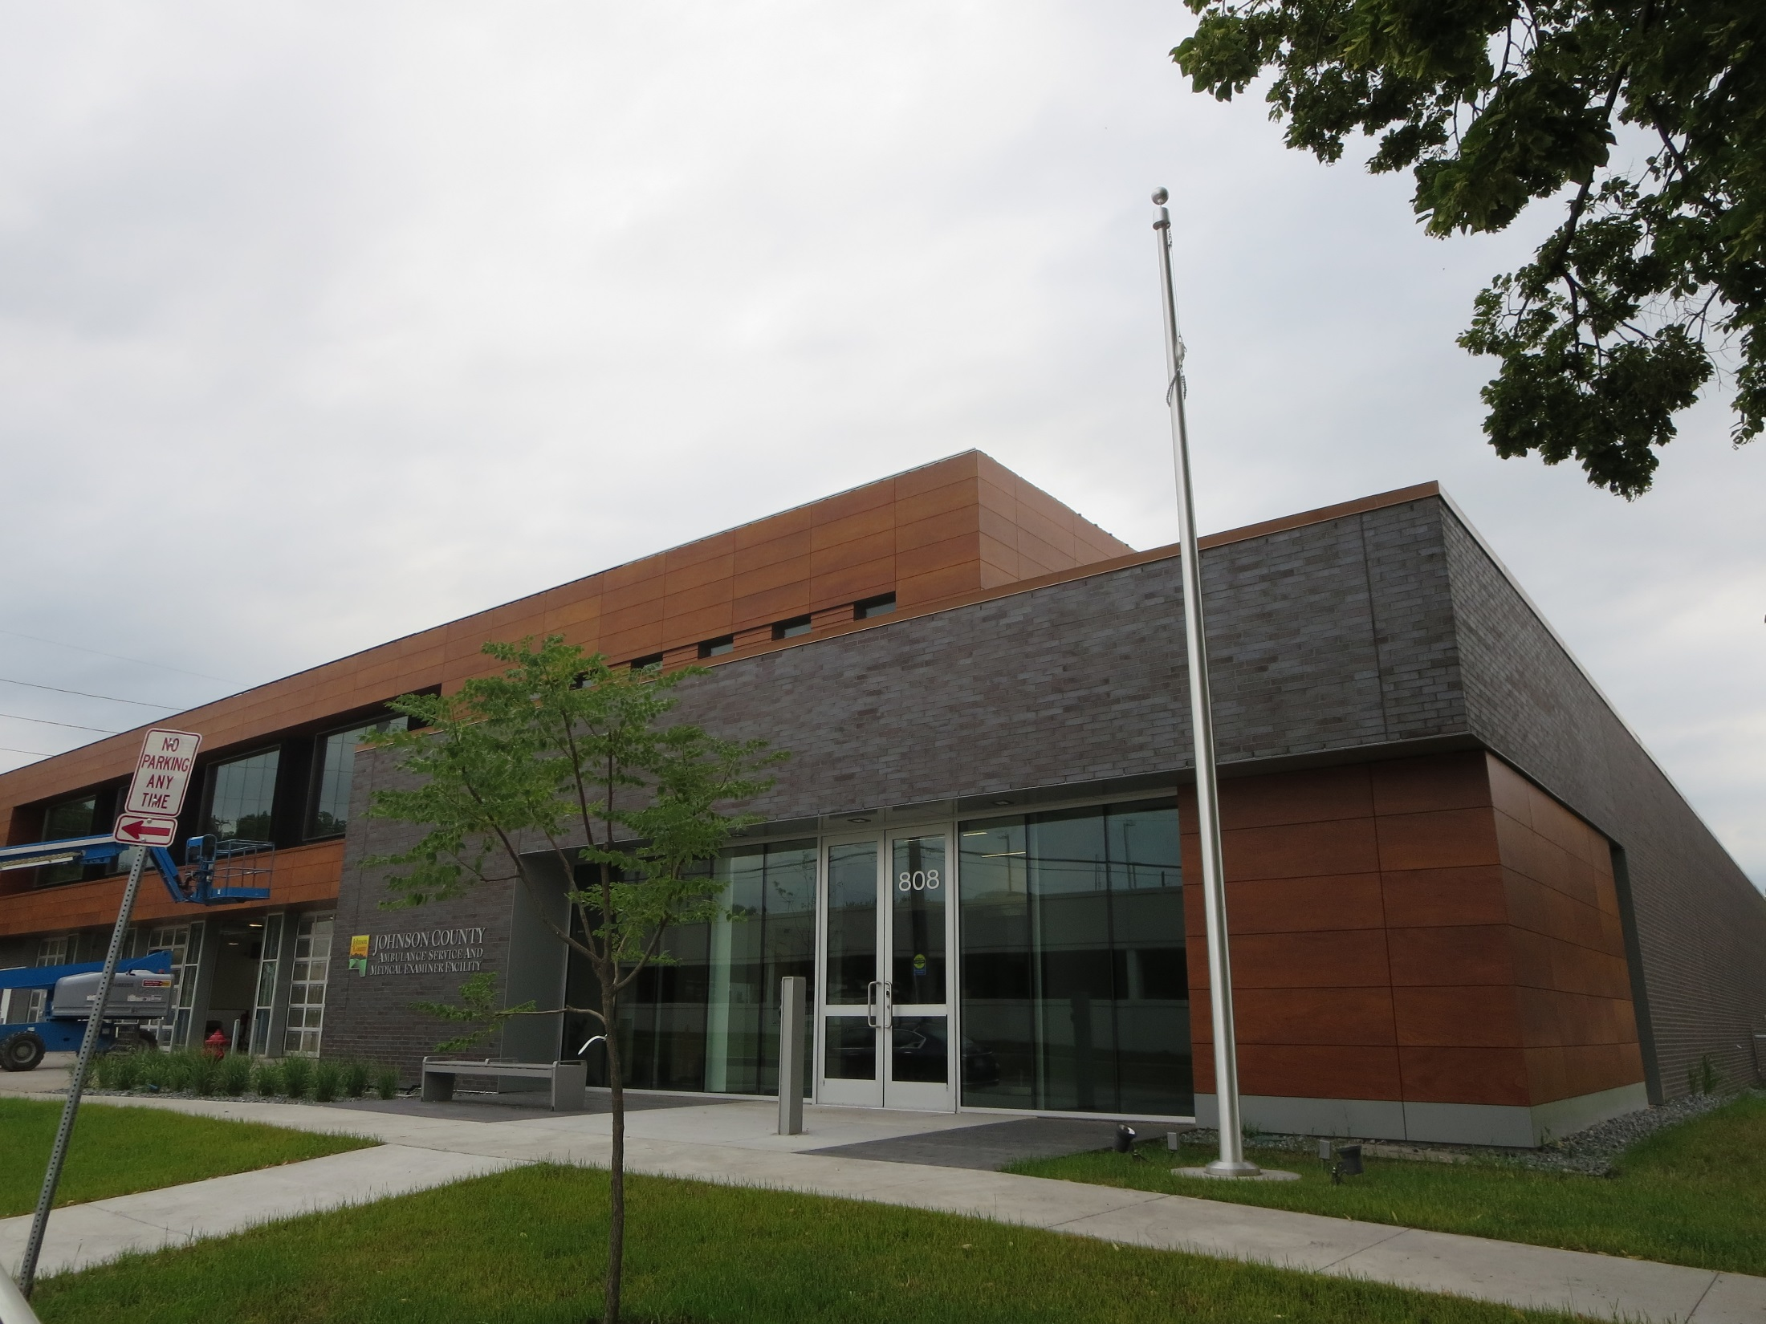
Latest Project
First outright purchase
Contracted with engineers: design/consult
Notes:
This building opened in July 2017
Home to Ambulance Services, Medical Examiner and Physical Plant.
Solar projects are very site and budget specific
In particular...whether or not you intend to use a PPA or do an outright purchase is an important decisions.

Slide 27
SOLAR for Johnson County Operations | Size* (kW) | Year One Production kWh (.5% annual decrease) | Type | Finance Type (Power Purchase Agreement = PPA)** | Cost^{Ɨ} | PPA pay off date
Secondary Roads Fleet and Wash Bay | 15.12 | 20,078 | Ground | PPA (10-year) | included in amount below | 2025
Secondary Roads Shop | 70.56 | 93,697 | Ground | PPA (10-year) | $127,628 | 2025
Administration Building | 85.8 | 113,000 | Roof (ballast) | PPA (20-year) | $274,086 | 2036
Health and Human Services Building | 159.6 | 195,000 | Ground | PPA (20-year) | $472,743 | 2036
Ambulance Service and Medical Examiner Facility | 68.85 | 80,648 | Roof + trellis | Outright purchase | $126,706 | not applicable
TOTALS | 399.93 | 502,423 |  |  | $ 1,001,163
Notes:
**Values include termination fees. Early buyouts allowed, which would decrease total cost.
Ɨcost listed is for array materials and install (Sec Rds had additional service upgrade costs; Admin array had additional fence costs; AME array had additional design and consult fees)
We additionally purchase solar shares (thus, not an onsite array) through Farmers Electric Cooperative for two Secondary Roads sheds.

Slide 28
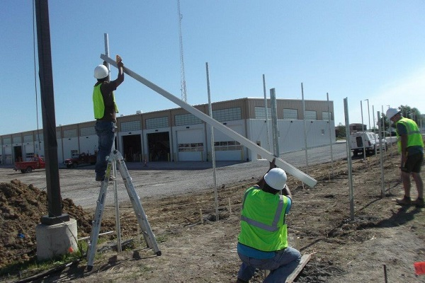
Process
1. Energy Efficiency Projects
2. Feasibility + Preparedness
3. Request for Proposals (RFPs) or Bid
4. Proposal Assessment / Selection
5. Power Purchase Agreement (PPA) or Outright Purchase
6. Interconnection Agreements+Inpspections, etc.
7. Public Awareness
Notes:
Overall process, which includes seven steps.
EE is important as a first step.
We have gotten $500,000 in rebates since 2014.

Slide 29
Overall Needs
TYPE
You will probably still buy energy from your utility
ADMIN BLDG | kWh (annual) | Percent
Total need | 480,000 | 100%
Provided by solar | 113,000 | 23.5%
Provided by utility | 367,000 | 76.5%
Notes:
This slides shows you usually still buy some energy from the utility even after you add an array.
For our admin bldg.
The total electrical need is 480000 kWh each year.
The array provides us almost one-quarter of that with 113,000 kWh
And you see we’re still getting just over three-quarters of our electricity from the grid
If asked, HHS is
1,614,185 kWh annual need
195,000 kWh solar (12%)
Remaining utility
Energy v. power: https://ctlsys.com/support/energy_kwh_vs-_power_kw/

Slide 30
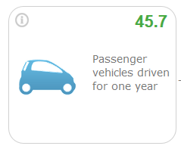
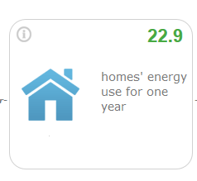
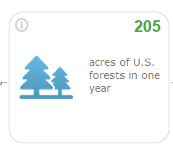
Expected Annual Results Admin + HHS Solar Arrays 308,000 kWh
Like avoiding greenhouse gases from…
Like avoiding CO₂ emissions of…
Equal to carbon sequestered by…
Source: https://www.epa.gov/energy/greenhouse-gas-equivalencies-calculator
Notes:
We also like to communicate the benefits of our solar arrays to the public
You can generate these statistics at the EPA energy website
If you value C)2 at 10 to 13 per metric tonne it’s like avoid $2,500 of damage a year; 62K over 25 years
(Primary GHGS are
C02 (81%),
methane (11%),
nitrous oxide(6%)and
fluorinated gases (3%).

Slide 31
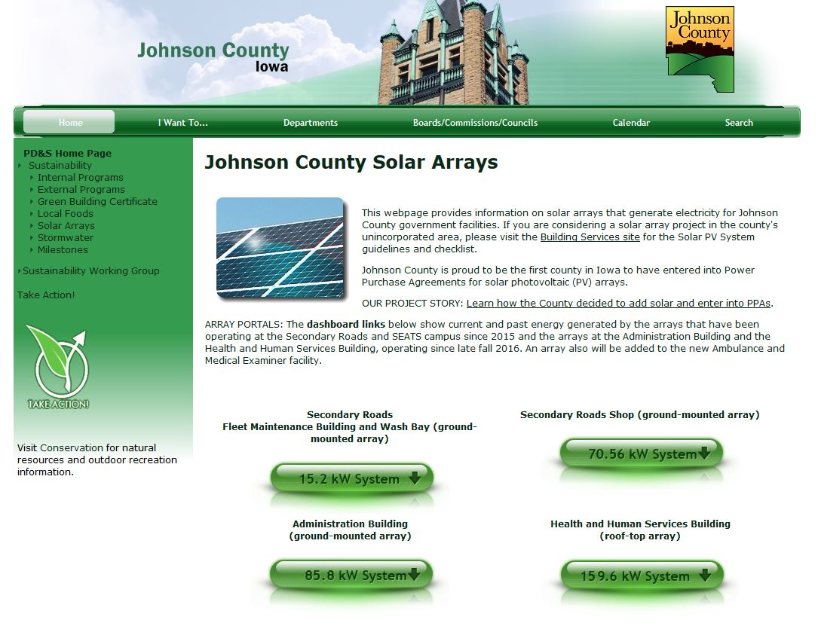
www.johnson-county.com/solar
Notes:
We have online portals so the public can see the arrays at work.
You can visit it, too, at url shown on upper left.

Slide 32
Questions?
www.johnson-county.com/solar

