Slide 1
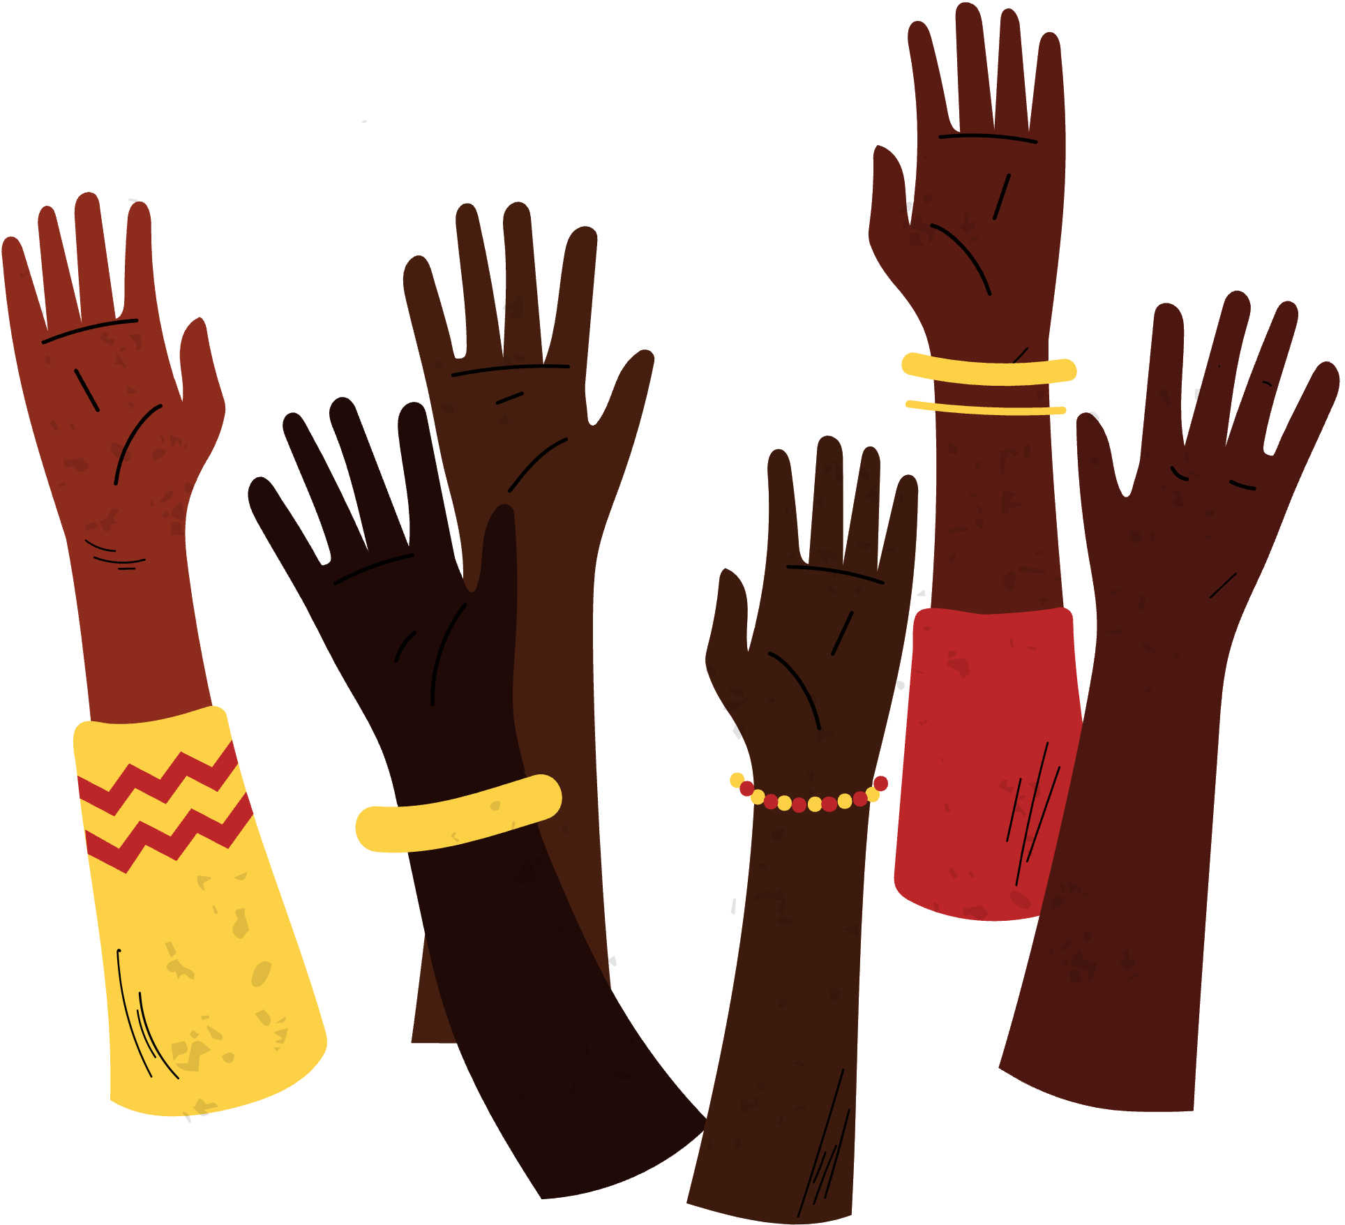
Progressive Action for the Common Good
presents

Slide 2
I Am the Future:
Standing on the Shoulders of the Past
With a Legacy Panel discussion featuring
MacArthur Cotton
Freedom Rider and
Veteran of the Mississippi Civil Rights Movement

Slide 3
PACG would like to thank our cosponsors:
Figge Art Museum
WQPT PBS
WVIK NPR

Slide 4
This event was also made possible by the generosity of the following organizations, individuals, and anonymous donors:
100 Black Men of the Quad Cities
ASWAS, Inc.
Diocese of Davenport
Friends of MLK Interpretive Center
Iowa State Representative Ken Croken
Metrocom NAACP Unit #4019
Northwest Bank and Trust
One Human Family - QCA
Quad Cities Interfaith
Tracy and Ben Singleton
Smart Lexus of the Quad Cities

Slide 5
Thank you for attending our event today.
Join us for more!

Slide 6
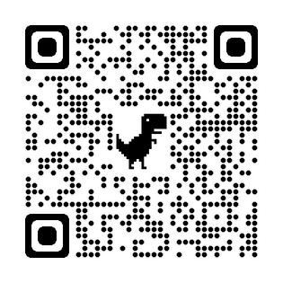
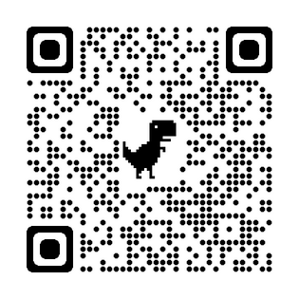
For information about the work
that PACG is doing, visit our website at www.pacgqc.org or use this QR code:
Donate to PACG here:

